Slide 1
Practical Design and Clear Reporting of Simulation Studies
Alexander Pate
alexander.pate@manchester.ac.uk
Notes:
Hope enjoying the event so far - 5 min intro
10 min ademp
15 mins examples

Slide 2
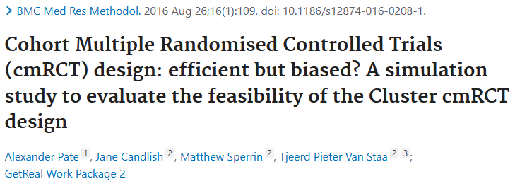
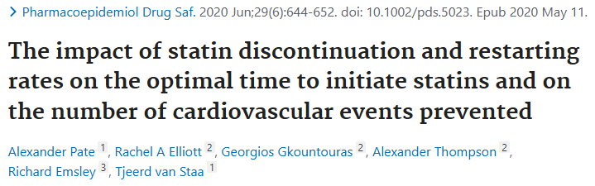
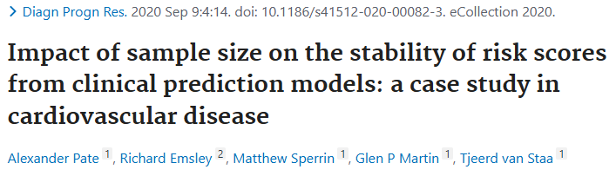
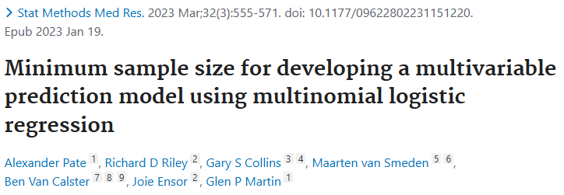
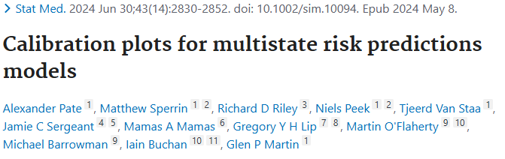
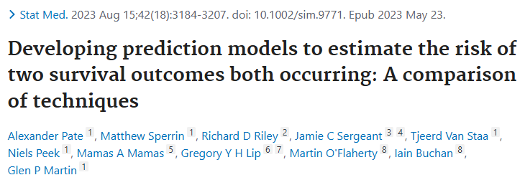
Why am I here?
Started working here in 2015
My research areas:
Quantifying uncertainty in prediction models
Methodology for the evaluation of prediction models
Prediction-under-intervention
A key tool for evaluating methodology, but discussions around their design somewhat limited
Interested to hear your opinions!
Notes:
My research background
A key tool but not the focus. No-one says their research interest is simulation studies themselves.

Slide 3

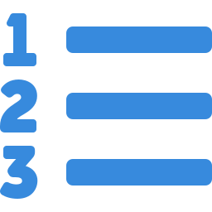



What do we mean by simulation?
Healthcare / clinical simulation
Discrete event simulation
System dynamics
Agent-based simulation
Digital twins
Mannequins, standardised patients, mock clinical environments to train or study clinicians. Not computational — the simulation is physical.
Entities (e.g. patients) move through a series of events over time. Used for patient flow, queues, and capacity planning.
Stocks, flows, and feedback loops model macro-level behaviour — e.g. epidemic trajectories via SIR/SEIR models.
Autonomous agents follow local rules; system-level behaviour emerges from interactions. Used in epidemiology, economics, social science.
A real-time digital replica of a specific entity (patient, hospital, system), continuously updated with live data for prediction and decision support.
Notes:
- System dynamics – infectious disease modelling

Slide 4
Monte carlo simulations
2
3
Apply methods
Assess performance
1
2
3
Estimate the quantity of interest using every method under comparison
Compare estimates to the known truth — compute bias, coverage, power
Simulate data
Apply methods
Assess performance
Compare estimates to the known truth
1
2
Define the estimand & select methods
Specify a data-generating process
The quantity to estimate and which statistical methods to compare
A statistical model representing a target population or scenario
Repeated many times

Slide 5
What I’m going to talk about today
ADEMP framework
Worked examples
Key concepts/discussion
Notes:
Tried to keep talk general, those interested in the detail, apologies.

Slide 6
ADEMP framework

Slide 7
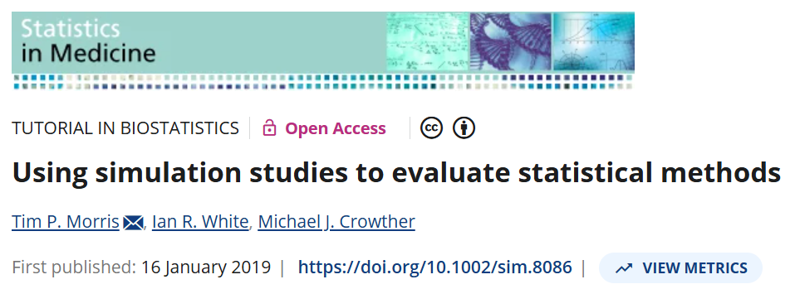
The ademp framework
Aims
Data Generating Mechanisms
Estimand (and other targets)
Methods
Performance metrics
Notes:
Reporting and designing…
We will use a toy-example running through

Slide 8
The ademp framework
State specific aims of the simulation study
Large or small sample performance?
Bias or variance?
Robustness to missspecification?
Aims
Data Generating Mechanisms
Estimand (and other targets)
Methods
Performance metrics
E.g. compare the performance of methods for predicting a binary outcome (Y) based on a set of predictors (X).

Slide 9
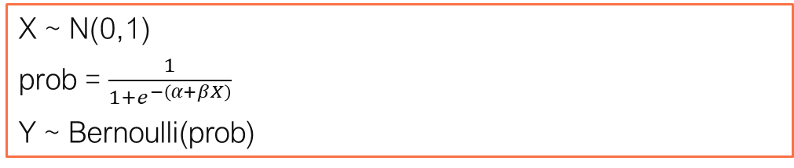
The ademp framework
What is the statistical process for generating your data?
Is the process fair?
Realistic or unrealistic?
Output in a format consistent with your analysis methods
Aims
Data Generating Mechanisms
Estimand (and other targets)
Methods
Performance metrics
X ~ N(0,1)
prob = $\frac{1}{1+e^{−\left(α+βX\right)}}$
Y ~ Bernoulli(prob)

Slide 10
The ademp framework
Range of input parameters to generate data for (i.e. scenarios):
Sample size
Number of predictors
Outcome prevalence
Amount of missingness, type of missingness
Explained variation/discrimination
Distribution shifts
Etc
Tension between realism/generalisability and tractability
A simulation that cannot be run, reported, or reasoned is of limited use, however realistic it may be.
Aims
Data Generating Mechanisms
Estimand (and other targets)
Methods
Performance metrics
Notes:
Ideally, we would model every source of variability and complexity present in the real world -> generalisable.
However, quickly becomes unmanageable.
Computation time grows
Results difficult to interpret
number of moving parts can obscure the patterns.

Slide 11
The ademp framework
What is the step-by-step process that can be followed in order to reproduce your results?
“In planning a simulation study, it is usual to spend more time deciding on data-generating mechanisms than any other element of ADEMP”
Aims
Data Generating Mechanisms
Estimand (and other targets)
Methods
Performance metrics

Slide 12
The ademp framework
The thing we are trying to estimate
Normally follows directly from the aim
Aims
Data Generating Mechanisms
Estimand (and other targets)
Methods
Performance metrics
The probability of having the event (Y) given the set of predictor variables (X).
P(Y|X)

Slide 13
The ademp framework
What methods are we comparing
Often identified through literature
Motivated by the aim
May just be one!
Aims
Data Generating Mechanisms
Estimand (and other targets)
Methods
Performance metrics
Logistic Regression; Support vector machine; Random forest; Decision trees; Neural Networks; Transformers.

Slide 14
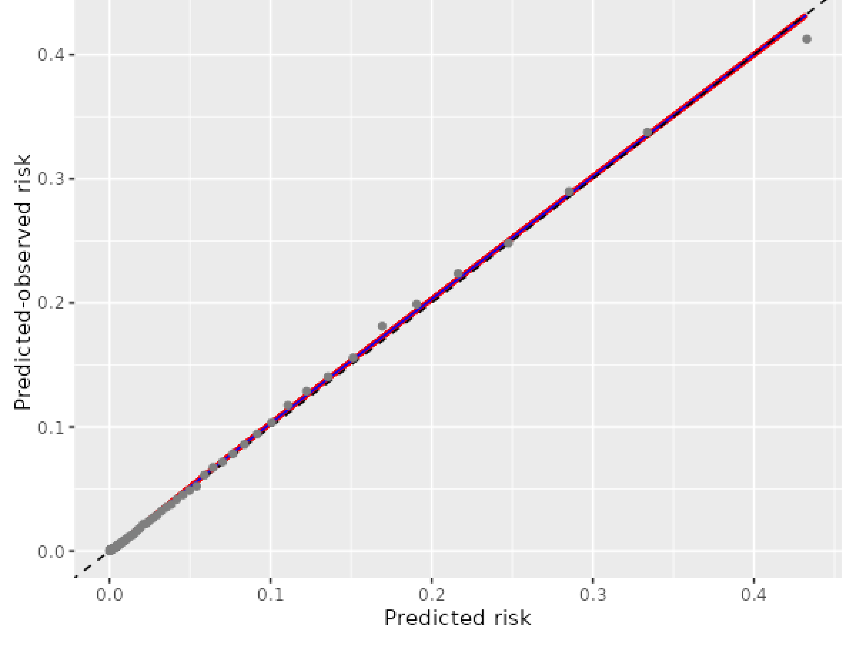
The ademp framework
How are we going to compare and evaluate the performance of the methods?
Bias; Variance; Coverage; Mean squared error; Calibration; Discrimination; Net-Benefit
Agnostic to the analysis methods
Monte Carlo Standard Error (the variability of simulation results)
Aims
Data Generating Mechanisms
Estimand (and other targets)
Methods
Performance metrics
Notes:
Out of bag for forest, something based on the likelihood function for logistic regression.
Link back to aims. Was it calibration? Discrimination? Or just general performance?

Slide 15
The ademp framework
It’s a framework/starting point
Aims
Data Generating Mechanisms
Estimand (and other targets)
Methods
Performance metrics

Slide 16
example #1

Slide 17
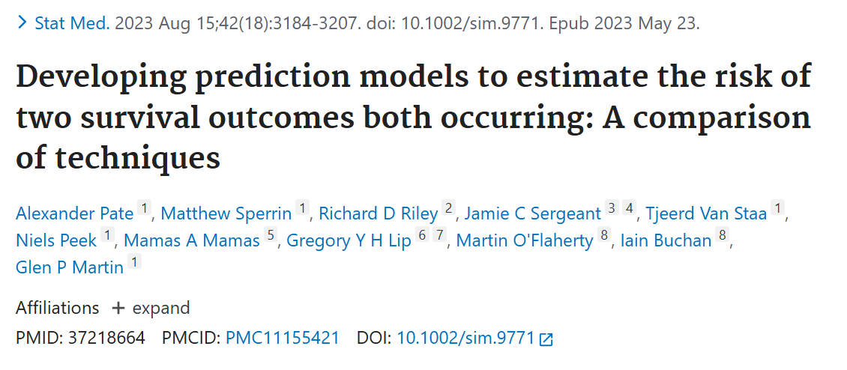
Example #1 – Clinical prediction models to estimate the risk of two survival outcomes both occurring
Study Background
There are several clinical settings where predicting the risk of two outcomes (A, B) both occurring is of interest
E.g. risk of stroke/major bleeding for individuals on anticoagulants
Issue is if the two outcomes are dependent after adjusting for all predictors.
A range of methods available, but no simulation studies comparing their performance.

Slide 18
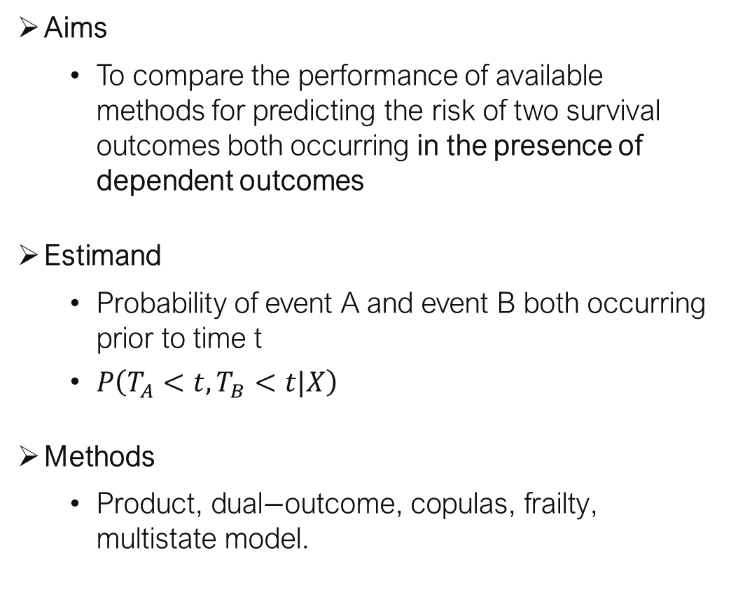
Example #1
Aims
To compare the performance of available methods for predicting the risk of two survival outcomes both occurring in the presence of dependent outcomes
Estimand
Probability of event A and event B both occurring prior to time t
$P\left(T_{A}<t,T_{B}<t|X\right)$
Methods
$\text{Product}\text{, }\text{dual}\text{−}\text{outcome}\text{, }\text{copulas}\text{, }\text{frailty}\text{, }\text{multistate} \text{model}\text{.}$

Slide 19
Example #1 - DATA GENERATING MECHANISM
Statistical process for simulating the data:
Identified 6 different ways to simulate multi-outcome data with dependence between the outcomes
Each aligned with one of the different analysis methods
Study became about model misspecification
Notes:
If you can simulate methods agnostic to the methods being applied, that is great.

Slide 20
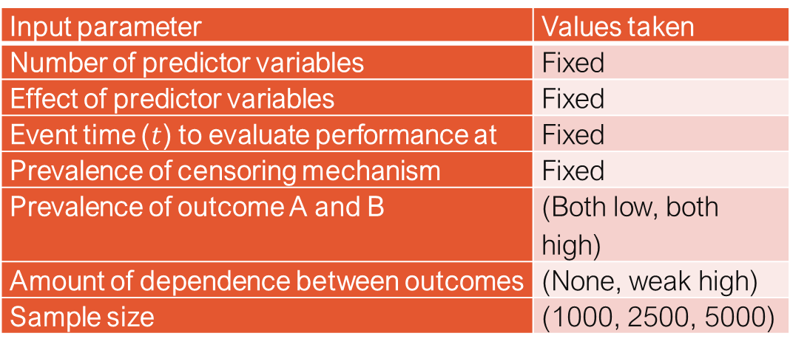
Example #1 - DATA GENERATING MECHANISM
Range of input parameters
Results in 6 (DGMs) * 3 (residual dependence) * 2 (outcome prevalence) * 3 (sample sizes) = 108 scenarios.
Input parameter | Values taken
Number of predictor variables | Fixed
Effect of predictor variables | Fixed
Event time ($t$) to evaluate performance at | Fixed
Prevalence of censoring mechanism | Fixed
Prevalence of outcome A and B | (Both low, both high)
Amount of dependence between outcomes | (None, weak high)
Sample size | (1000, 2500, 5000)
Notes:
When choosing what to vary
Is there a reason to vary this input parameter?
Do we expect it to impact conclusions?
Do we expect it to interact with the other input parameters?
Choose 1 key scenario (base this on real data), and then vary things one by one

Slide 21
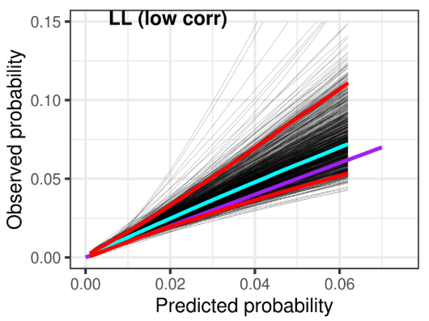
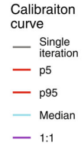
Example #1
Performance metric
Calibration curves
Performance metric
Observed / True probability
Notes:
Not going to focus on all results
Focus on calibration curves
Would need 864 of these plots.
Shortcuts possible….

Slide 22
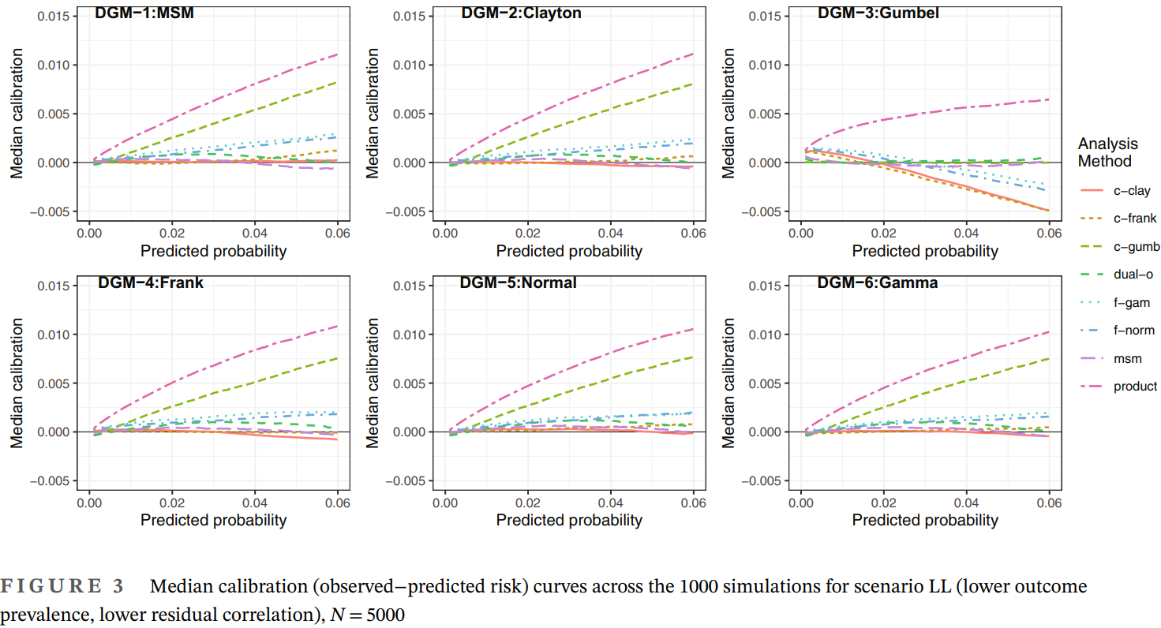
Example #1
Performance metric
Median of the calibration curves
Notes:
108 of these

Slide 23
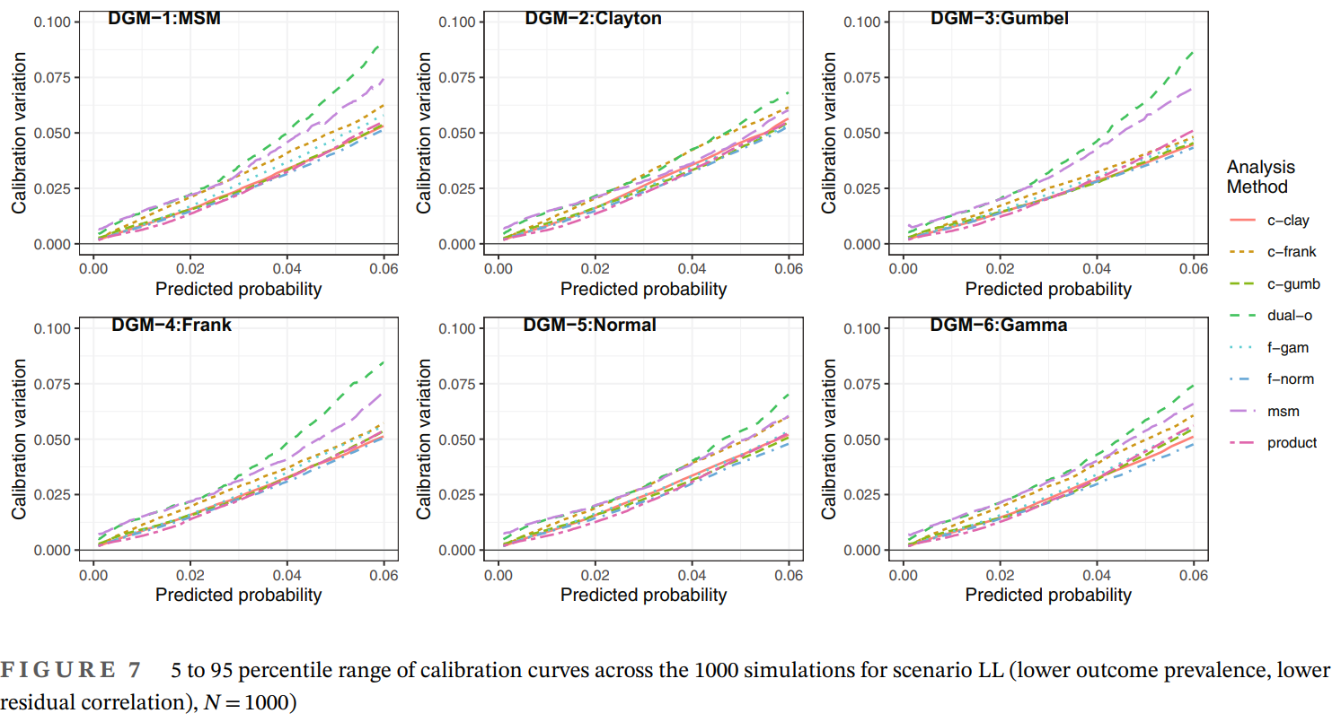
Example #1
Performance metric
Variation in calibration curves
Notes:
108 of these
Important to consider when choosing performance metrics and parsing results

Slide 24

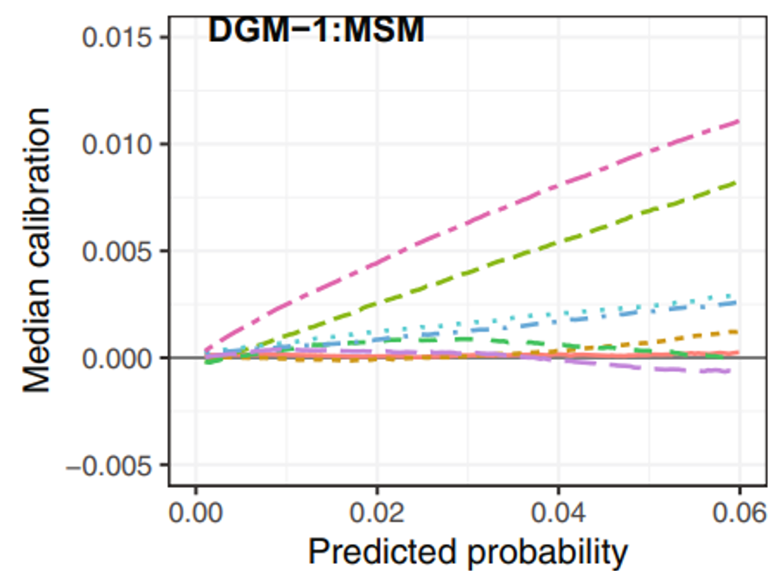
Example #1 - time machine
Performance metric
Lines difficult to differentiate
Tables for numerical metrics (e.g., mean bias of the median calibration curve!)
Choose less methods
No Monte Carlo Error
How accurate are these results?

Slide 25
example #2

Slide 26
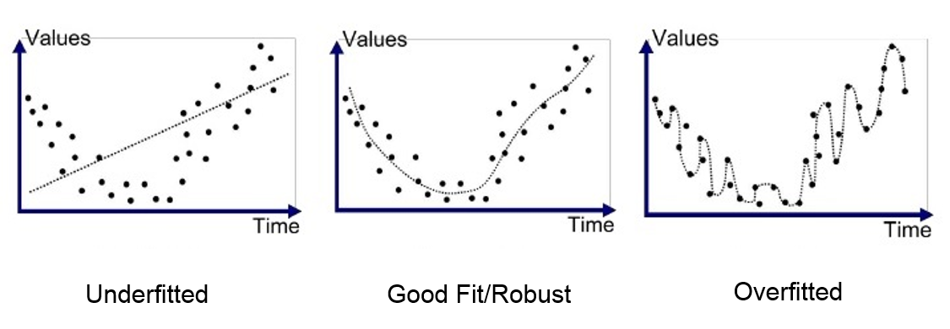
Example #2 – performance of the Heuristic shrinkage factor
Aim
Evaluate performance of the “heuristic shrinkage factor” when estimating the global shrinkage factor
Estimand
Global shrinkage factor (S)
Methods
Heuristic shrinkage factor, bootstrapped shrinkage factor
Data Generating Mechanism
Replicated the process of developing and validating a logistic regression model
Generated inputs (N, C, Q, Ω) at random
shrinkage
Two estimators (heuristic, and bootstrapped)
Simulate the input parameters at random
No specific parameter of interest, so vary them all at random
Two ways to generate the data
Image source: https://medium.com/swlh/machine-learning-how-to-prevent-overfitting-fdf759cc00a9
Notes:
Overfitting is the modelling of random noise

Slide 27
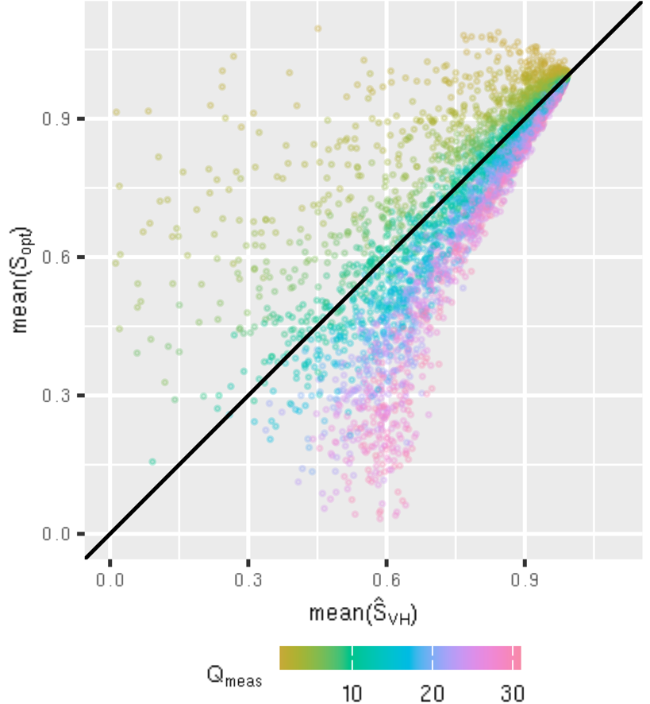
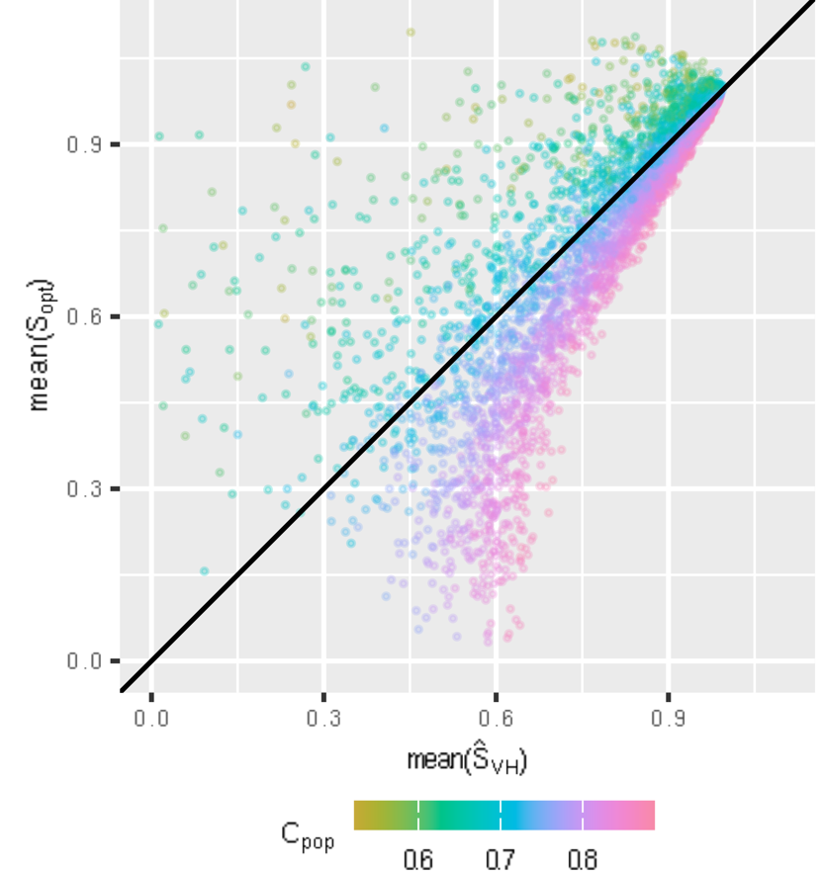
Example #2
Plotted by Q_{meas}
Plotted by C_{pop}
DGM-1
Q_{meas} = number of predictor variables
C_{pop} = discrimination of the model

Slide 28
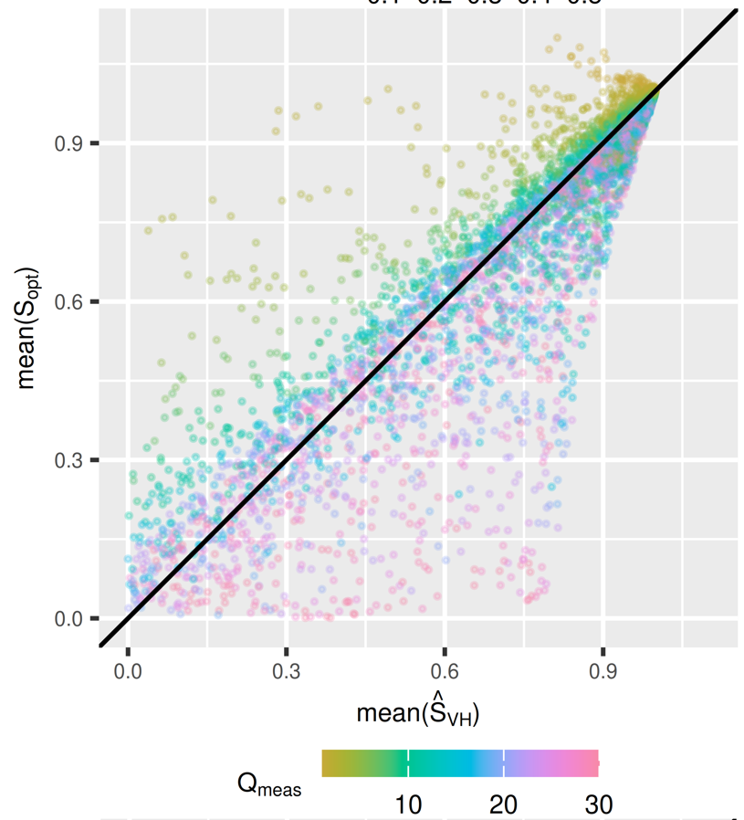
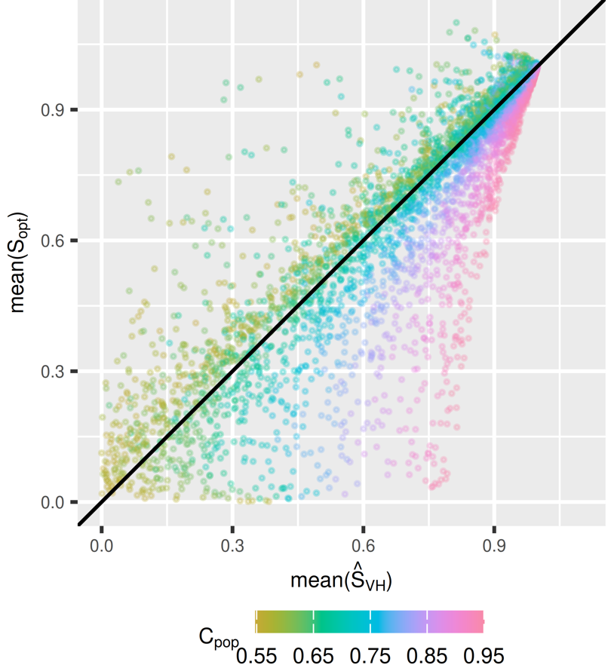
Example #2
Plotted by Q_{meas}
Plotted by C_{pop}
DGM-1
Q_{meas} = number of predictor variables
C_{pop} = discrimination of the model
DGM-2

Slide 29
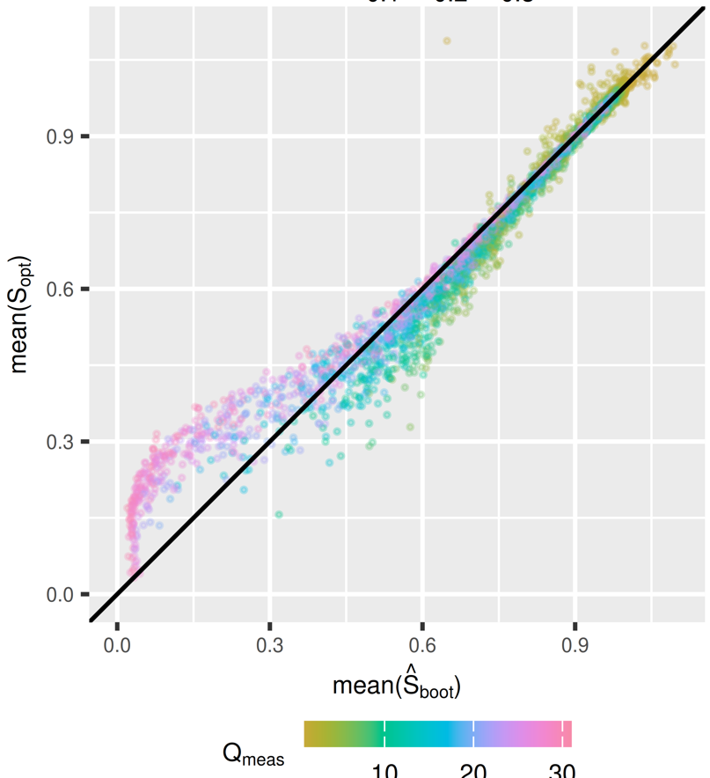
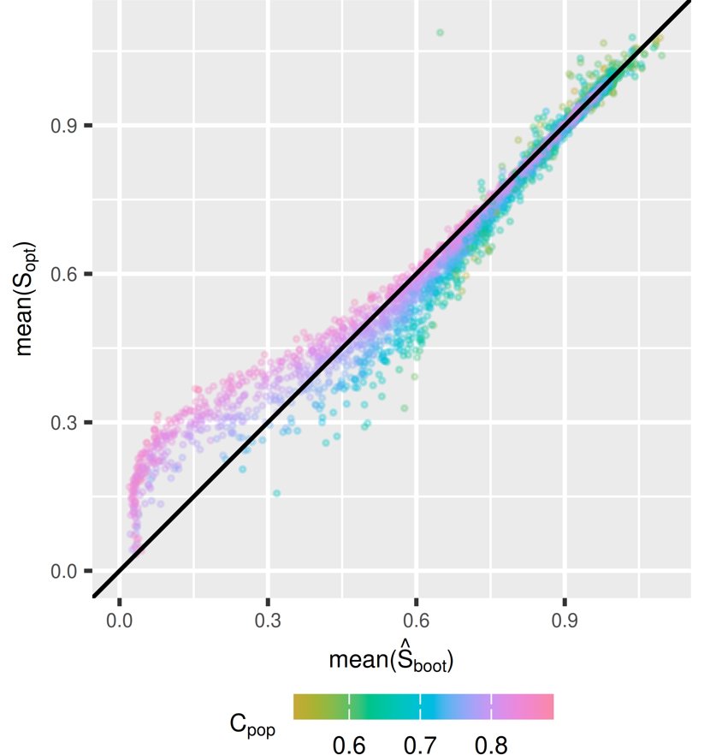
Example #2
Plotted by Q_{meas}
Plotted by C_{pop}
DGM-1
Q_{meas} = number of predictor variables
C_{pop} = discrimination of the model

Slide 30
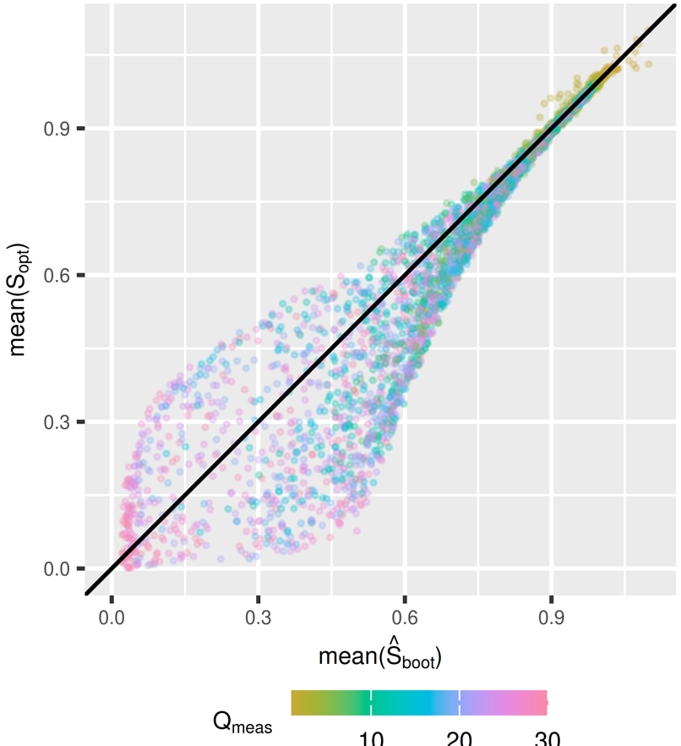
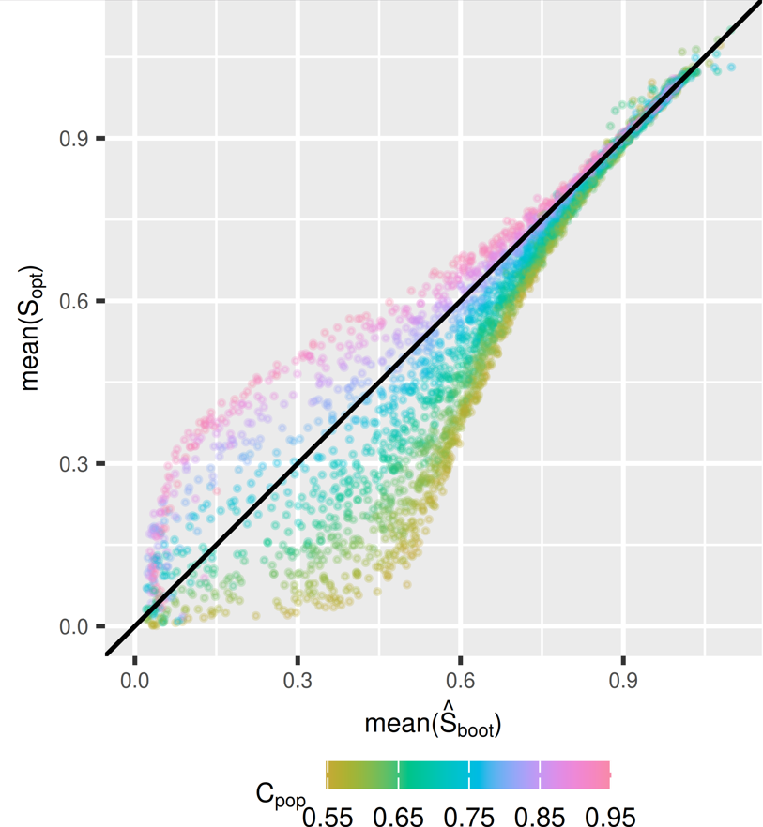
Example #2
Plotted by Q_{meas}
Plotted by C_{pop}
DGM-1
Q_{meas} = number of predictor variables
C_{pop} = discrimination of the model
DGM-2

Slide 31
Key concepts

Slide 32
KEY concepts
With every design decision, remember the aim
Consider the fairness and impact of the data generating mechanism
Consider realism/complexity vs tractability
What are the most informative performance metrics?
Large sample vs small sample (bias vs variability)
Design of a data simulator:
Keep the DGM flexible
Consider computational efficiency carefully
Interactive application for presenting results
Simulation should be fully reproducible, including random number seeds

Slide 33
KEY reference
Notes:
Don’t want to force ADEMP, use your intuition, but it’s a great base for starting

Slide 34

THANK you for listening!

Slide 35
An actual example (2)

Slide 36
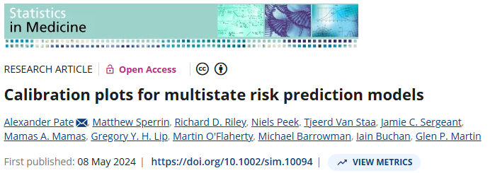
Calibration plots for multistate risk prediction models
Notes:
I think a running example would be useful…

Slide 37
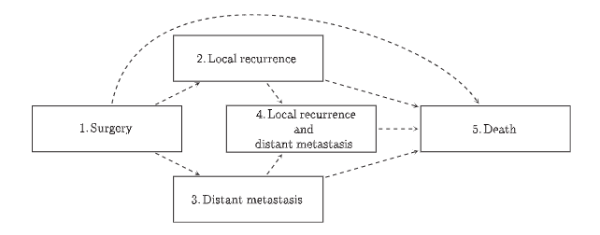
Calibration plots for multistate risk prediction models
Study Background
Multistate models are commonly developed in practice
Lack of methodology to evaluate their performance
Specific issue is how to deal with censoring
We aimed to develop methods to assess calibration of multistate models
Notes:
I think a running example would be useful…

Slide 38
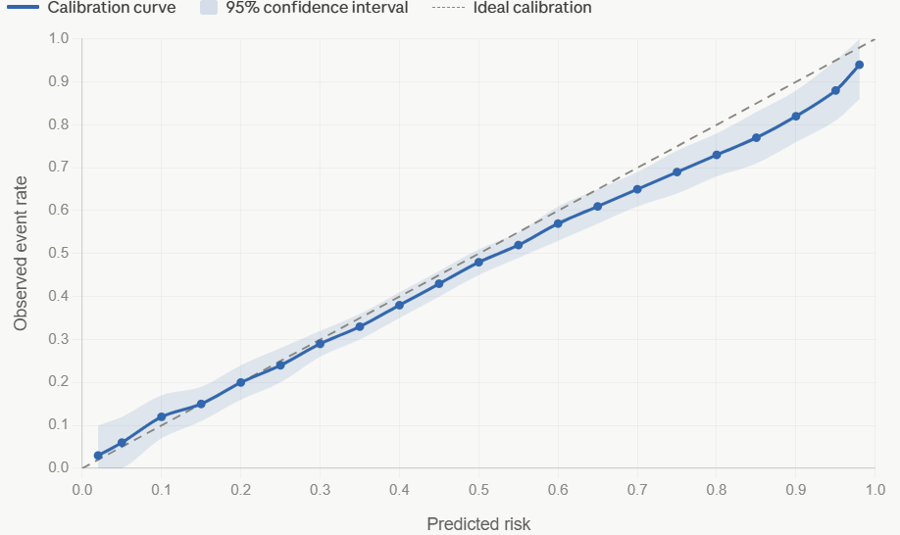
Calibration plots for multistate risk prediction models
Aims
To compare the bias (and variability) of each of the calibration methods under different levels of dependent censoring
Estimand
The true calibration curve
Methods
BLR-IPCW; MLR-IPCW; PV
Notes:
I think a running example would be useful…

Slide 39
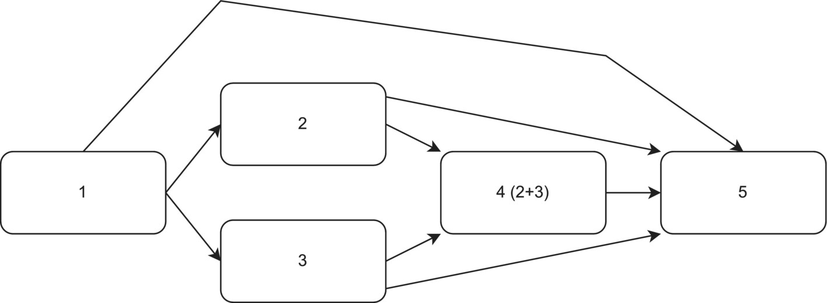
Calibration plots for multistate risk prediction models – DATA generating mechanism
What needed to be simulated?
Some predictors X
Event times under a multistate framework
Time until censoring event
Dependence between the censoring event and event times
Notes:
I think a running example would be useful…

Slide 40
Calibration plots for multistate risk prediction models – DATA generating mechanism
Large sample simulation Process
Simulate a validation dataset of size 200,000
Calculate the true transition probabilities
Define perfectly calibrated risks, over predicted risks, and under predicting risks.
Assess calibration of these ‘predicted’ risks using each method
Compare calibration to true calibration
Notes:
Create a visual representation of how we didn’t fit the model

Slide 41
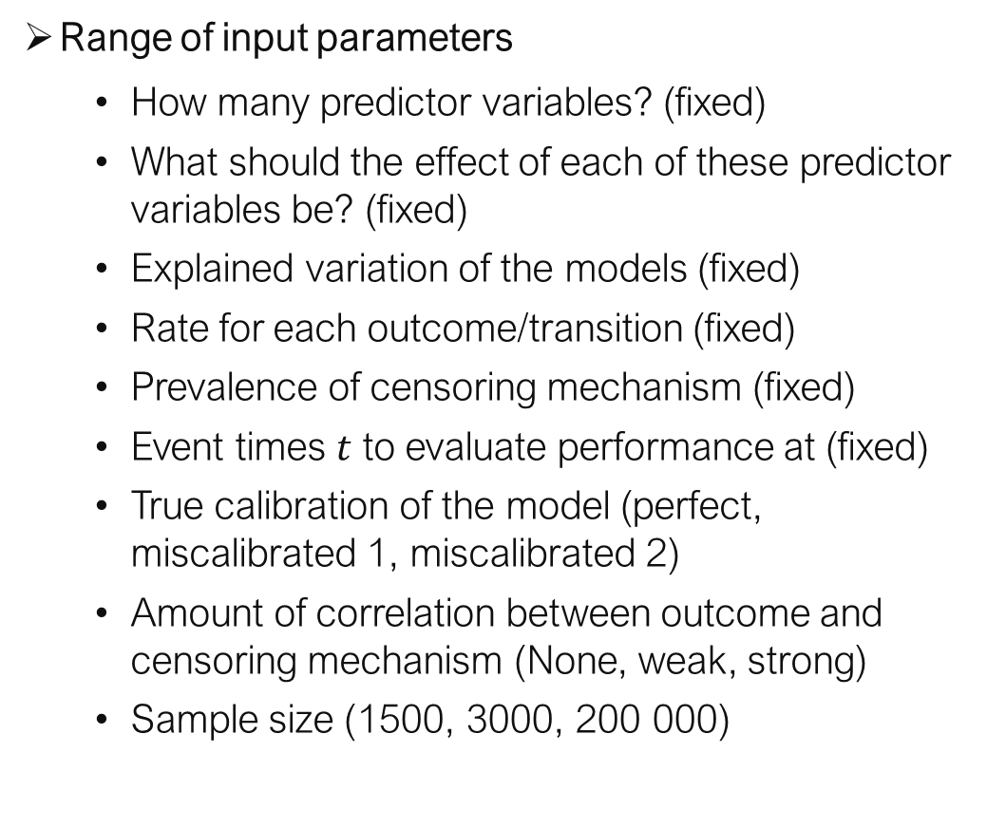
Calibration plots for multistate risk prediction models – DATA generating mechanism
Range of input parameters
How many predictor variables? (fixed)
What should the effect of each of these predictor variables be? (fixed)
Explained variation of the models (fixed)
Rate for each outcome/transition (fixed)
Prevalence of censoring mechanism (fixed)
Event times $t$ to evaluate performance at (fixed)
True calibration of the model (perfect, miscalibrated 1, miscalibrated 2)
Amount of correlation between outcome and censoring mechanism (None, weak, strong)
Sample size (1500, 3000, 200 000)
Notes:
I think a running example would be useful…

Slide 42
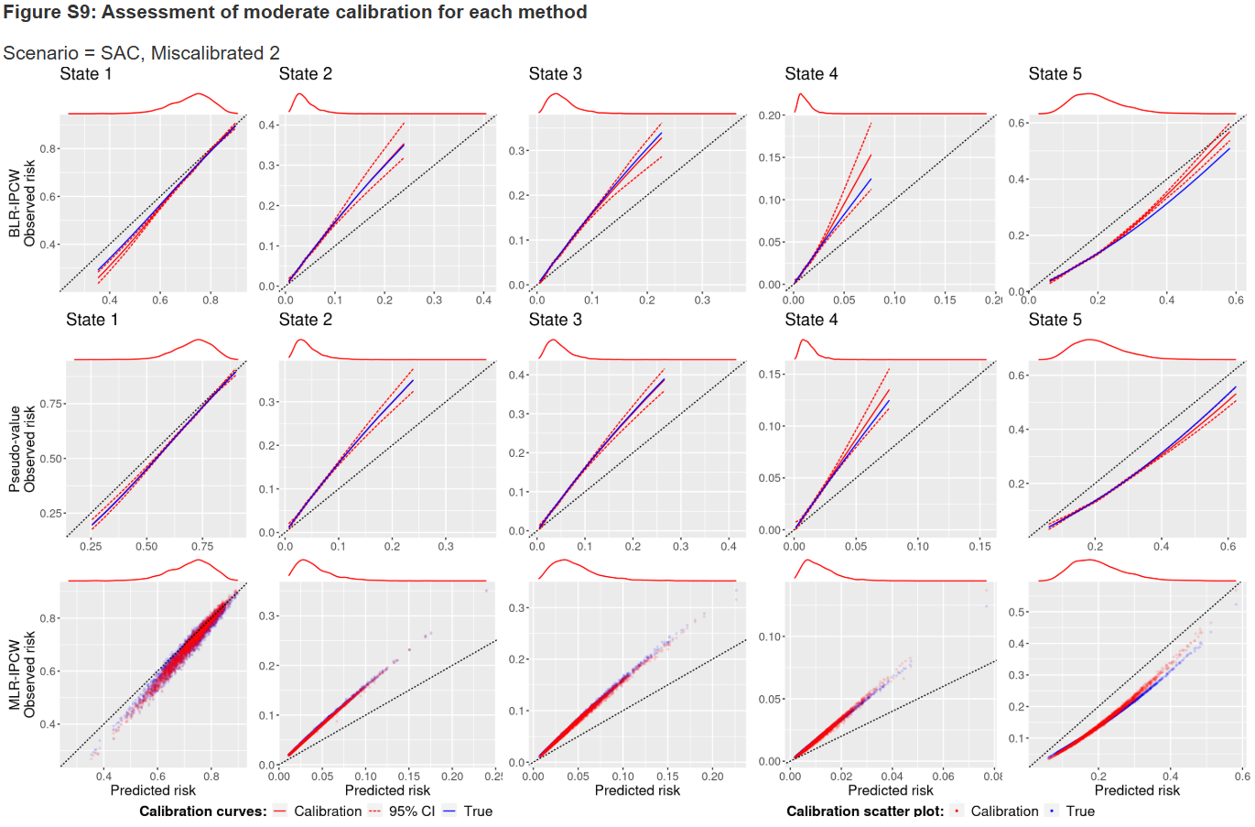
Calibration plots for multistate risk prediction models
Performance metric
Notes:
Would need

Slide 43
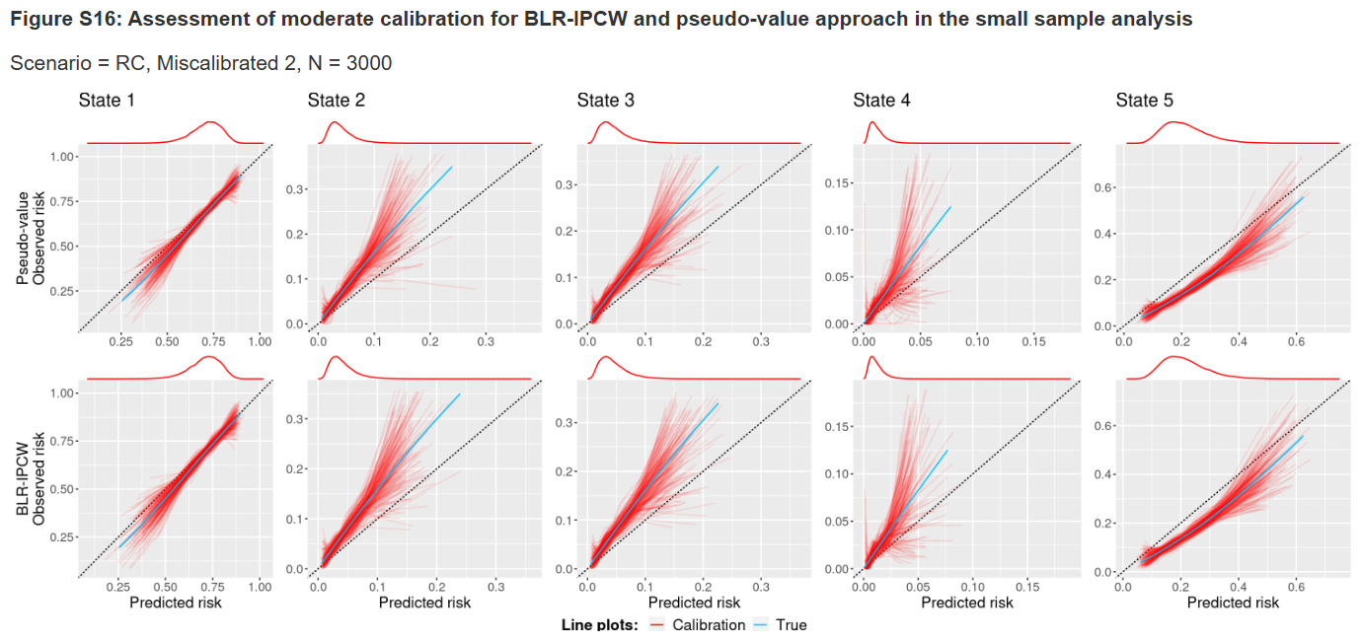
Calibration plots for multistate risk prediction models
Performance metric
Moderate calibration curves, small sample
Notes:
Would need

Slide 44
Calibration plots for multistate risk prediction models
Performance metric
Whats interesting about this one is:
- DGM no longer an issue
The estimand is a performance metrics (inception?)
The data generating mechanism reflected that and cut out the model fitting part as it wasn’t neccesary
No Monte Carlo Error
How accurate are these results?
Sample sizes were small
What about large sample performance?
Notes:
I think a running example would be useful…

